Slide 1
SpongeBook
An Interactive Social Media Platform for Spongebob Characters
By Kevin Endo, Khadeja Khalid, Christopher Gentibano, Tiffany Tran, Brandon Pham, Weiyuan Chen
Notes:
Chris dawg

Slide 2
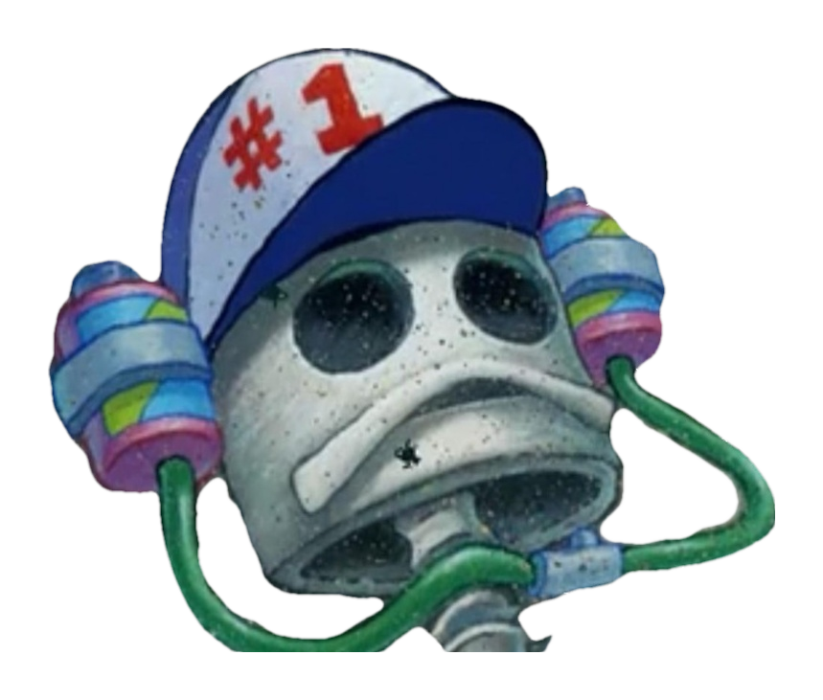
Outline
Summary
Data Set
Data Structures
UML Diagram
Walkthrough
Trial & Error
Live Demo
Notes:
Chris dawg

Slide 3
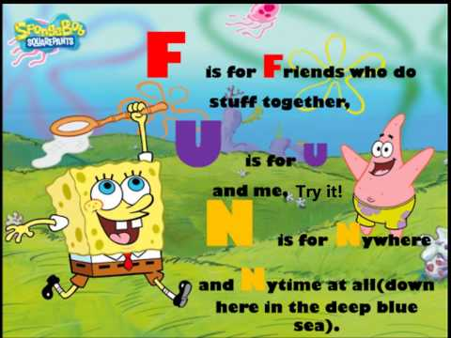
Summary
An interactive social media platform for Spongebob Characters (similar functionality as Facebook)
View profiles (name, location, interests, friends)
Friend recommendations.
Search by name & interests
Add & remove friends
View friends
Log in
Notes:
Tiff dawg

Slide 4
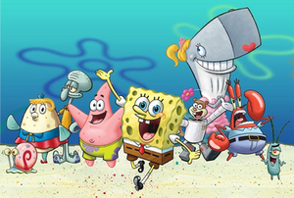
Data Set
Spongebob Squarepants
Patrick Star
Sheldon Plankton
Flats Flounder
Pearl Krabs
Mermaid Man
Barnacle Boy
Sandy Cheeks
Smitty Werbenjagermanjenson
Flying Dutchman
Squidward Tentacles
King Neptune
Mrs. Puff
Gary Snail
Al Pris
Eugene Krabs
www.spongebob.wikia.com
Each user has:
Firstname & Lastname
Username & Password
City, State
List of Friends
List of Interests
Notes:
Kev dawg

Slide 5
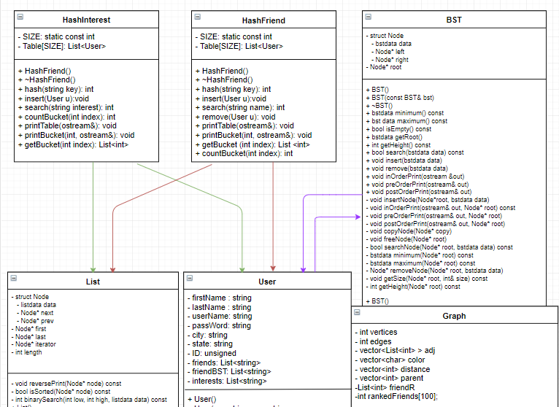
Data Structures
★Linked List
Directly used with HashInterest, HashFriend, Graph, and User
★Binary Search Tree
This data structure is used to search for friends within the specific user’s login using a vector
★HashFriend
Sorts a user’s friends into a hash table and allows the user to search by friend’s name
★HashInterest
Sorts the user’s interests into a hash table and allows the user to search by interest
Notes:
Joe dawg

Slide 6
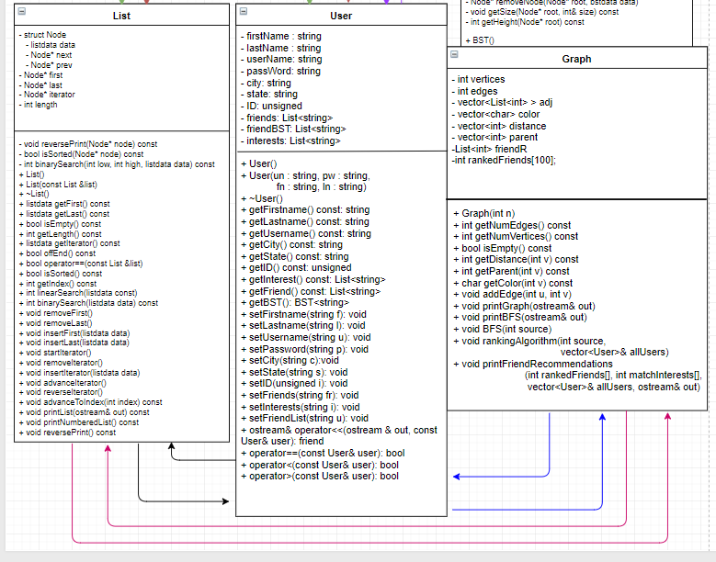
Data Structures
★Linked List
Directly used with HashInterest, HashFriend, Graph, and User
★Graph
Searches users with an edge < 1, matches common interests, and suggests friend recommendations based off of results
(distance - common interests) -> ordered by smallest number
★User
Stores all the information of a user and passes to its appropriate location
Notes:
Khadeja dawg

Slide 7
Data Structures
Notes:
Idk dawg

Slide 8
Walk-Through
★Participant 1:
In login screen
1)login 2) create an account and 3)quit.
User entered 4 and descended into infinite loop.
Feedback:
Loop back if invalid input
Changes:
Menu loops back around if user entered a choice other than 1, 2, or 3
★Participant 2:
After logging in as Patrick, viewing all friends did not display the correct names. Only Spongebob’s friends were being displayed.
Feedback:
Other login users are not displaying the correct friend list.
Changes:
Updated data set.
Made sure UserID was set
to the user that was logged in.
Notes:
Brandawg

Slide 9
Walk-Through
★Participant 3:
Participant removed a friend
Friend was removed, but after selecting “View all friends”, friend was still on the list.
Feedback:
Update friend’s list
Changes:
Made sure that the User’s friend is being removed in the BST and Linked List.
Updated “data.txt” file to ensure the User’s changes are being saved.
★Participant 4:
Participant attempted to log in, then wanted to go back and create a new account, but couldn’t without stopping the program
Feedback:
Allow user to go back to menu at any instance
Changes:
User has the choice to go back
to menu if more than 3
invalid inputs were made
Notes:
Brandawg

Slide 10
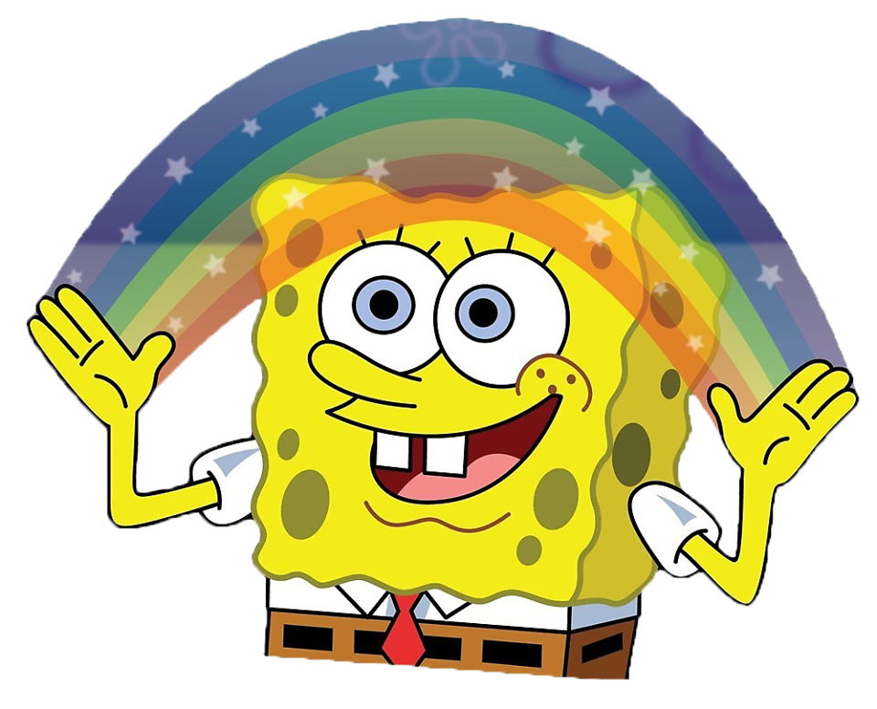
Live Demo
Notes:
we da dawgs

